Slide 1
A mobile, cross-platform, provider-independent solution for global positioning social networking.
Ernest Costa
Michael Daniels
Lindsay Graham
Erik Olson
Dion St. Hilaire
Faculty Sponsor
Dr. Richard Ford

Slide 2
Abstract
21st century Person – Telephone ratio 1:2
Over 3.3 Billion individual numbers

Slide 3
What we intend to do
Develop non-biased inter-provider “social network”
Socialize, Manage friends, transmit information between devices.

Slide 4
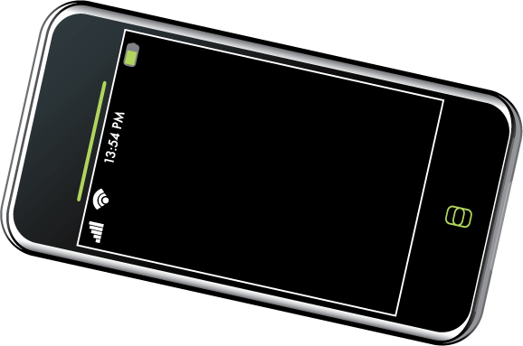
Break down barriers between carriers!

Slide 5
Motivation
Real life experiences.
Missed opportunities
More efficient and convenient real life interpersonal interaction

Slide 6
Project Goals
Expound upon existing protocols which are not free and operator specific.
Conjoin all these abilities in an effort to break down barriers between carriers.
Develop a stable and viable product across multiple platforms.

Slide 7
Features
Cross Carrier Communication
Privacy Settings
Secure Data Transmission
Easily expandable and portable
Direct dialing, SMS, etc…
Buddy Tracking

Slide 8
Project Milestone
Milestone 1
Create Requirements / Design / Test Documentation
Milestone 2
Have basic framework in place for distribution on multiple platforms
Milestone 3
Have framework implemented on at least one platform with basic usability

Slide 9
Task Matrix
Task | Ernie | Mike | Lindsay | Erik | Dion
Requirements | 20% | 25% | 20% | 15% | 20%
Design | 20% | 20% | 20% | 20% | 20%
Test Design | 15% | 25% | 15% | 30% | 15%

Slide 10
Questions?

