Slide 1

Milestone 1
Ernie Costa
Michael Daniels
Lindsay Graham
Erik Olson
Dion St. Hilaire

Slide 2

Milestone 1
Requirements Document
Design Document
Test Document

Slide 3
Requirements Document
Features
  Buddy List
  Buddy List Grouping
  Privacy Settings
  Friend in Range
  Request Friend Location
  Send Friend Location
  User Status
  View Map
  Stolen Phone Trak

Slide 4
Requirements Document
Account Information
  Login Information
  Personal Information
  Personal Settings
  Privacy Settings

Slide 5
Requirements Document
Requirements by Application
  Client Application
  Web Interface
  Server Application

Slide 6
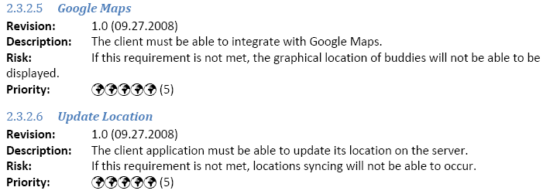
Requirements Document
Standard Requirement Form

Slide 7
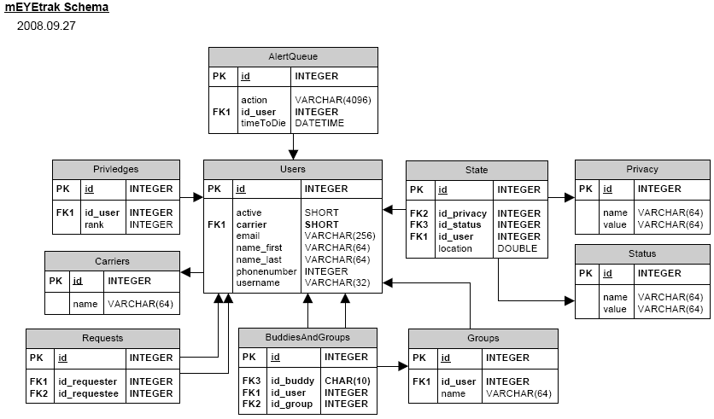
Design Document

Slide 8
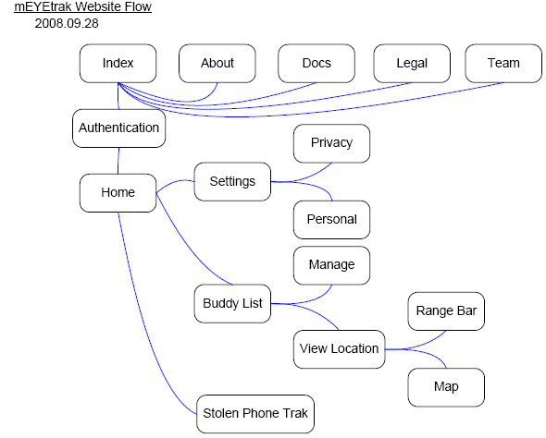
Design Document

Slide 9
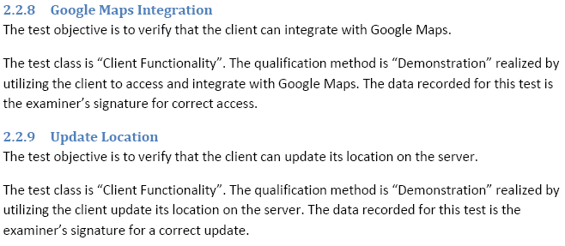
Test Plan
Every entry in the test plan maps to one or more requirements.

Slide 10
Questions?

