Slide 1
Milestone 2
Ernie Costa
Michael Daniels
Lindsay Graham
Erik Olson
Dion St. Hilaire

Slide 2
Milestone 2
Basic functionality for Client and Server applications
Communication between both applications
Implementation of Database schema

Slide 3
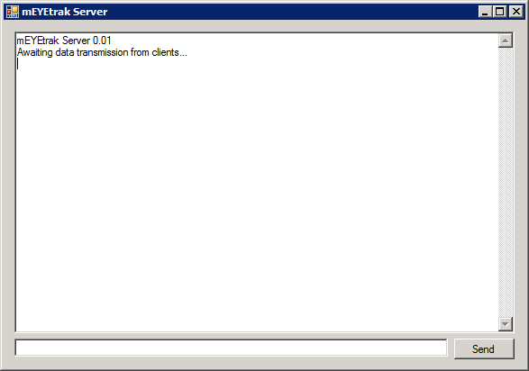
Communication between both applications

Slide 4
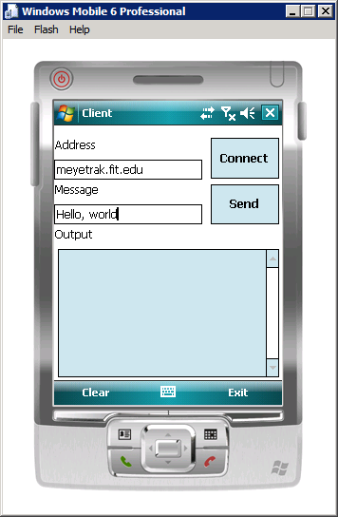
Communication between both applications

Slide 5
Basic functionality for Client & Server Applications
namespace mEYEtrak.Packets
{
class RequestAccountInfoPacket : IPacket
{
string _user;
DateTime _timestamp;
public RequestAccountInfoPacket(string user, DateTime timestamp)
{
_user = user;
_timestamp = timestamp;
}
public string User
{
get { return _user; }
set { _user = value; }
}
public DateTime Timestamp
{
get { return _timestamp; }
set { _timestamp = value; }
}
}
}

Slide 6
Communication between both applications
Demonstration

Slide 7
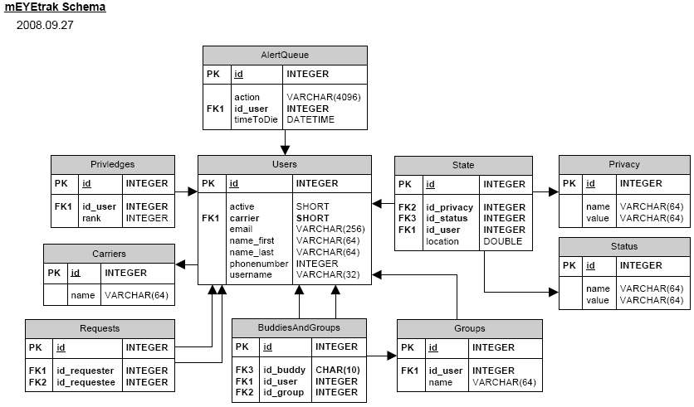
Implementation of Database schema

Slide 8
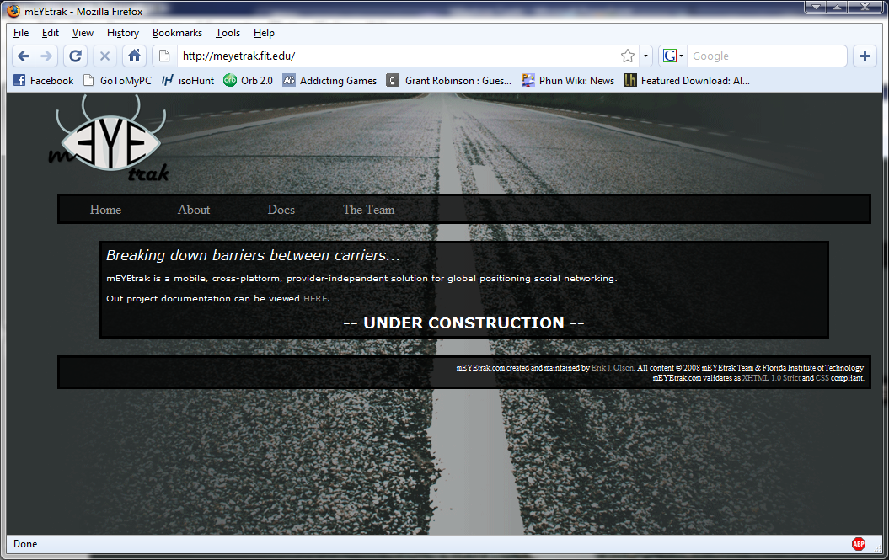
Implementation of Database schema

Slide 9
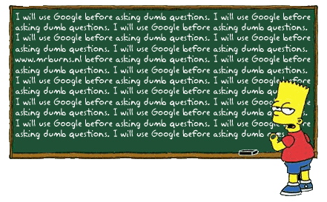
Questions?

