Slide 1

Milestone 3
Ernie Costa
Michael Daniels
Lindsay Graham
Erik Olson
Dion St. Hilaire

Slide 2

Milestone 3
Client Communication
Server Communication
GPS Integration
XML Parsing
XML Serialization

Slide 3


Client & Server
Communication
WWW
HTTPS connection to server
Post submission of XML
Server (PHP) performs appropriate actions
HTTPS response to device

Slide 4
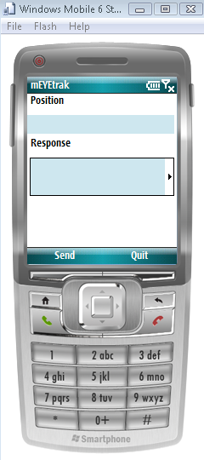
Client & Server
Communication
Client currently runs on all versions of Windows Mobile 6
(Standard, Classic, & Professional)

Slide 5
XML Parsing and Serialization
<xml>
<credentials timestamp=“333" email="e@mail.com" password="password"/>
<requests>
…
<gps id="updatelocation" action="updateLocation" timestamp="1227188998">
<longitude>-80.665253</longitude>
<latitude>28.056636</latitude>
</gps>
…
</requests>
</xml>

Slide 6

GPS Integration
<gps id="updatelocation" action="updateLocation" timestamp="1227188998">
<longitude>-80.665253</longitude>
<latitude>28.056636</latitude>
</gps>

Slide 7
Demo

Slide 8
Milestone 4
Account Creation
Buddy List Management
Client Application Interface

Slide 9

Questions?

