Slide 1
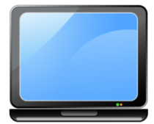
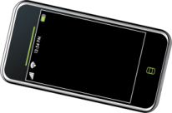
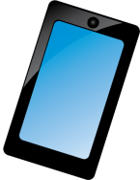
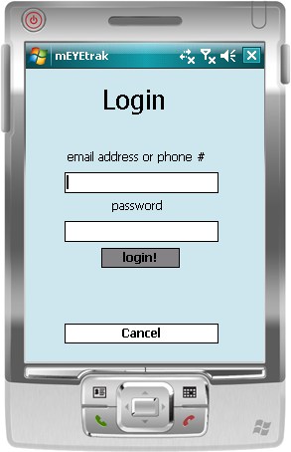
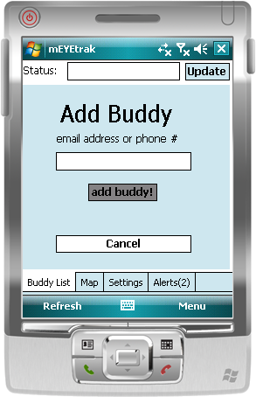
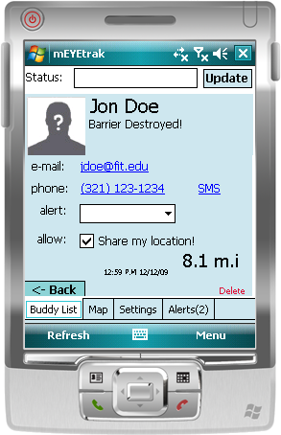
Project Statement
mEYEtrak is a cross-carrier mobile application used to communicate and locate friends in a secure, sociable manner. Users will have the ability to add buddies and exchange information between each other through a central server, providing a controllable means of securing that data.
While a few providers already offer a similar service, none of them are free, let alone independent of the originating “brand”. Boost Mobile users can only interact with each other on stock phones. Apple subscribers have iPhone programs that can email friends their GPS location via Google Maps, but not alert preset buddies when they're within a set distance. Other systems use a web-based interface on the device; something not all phone browsers can support.
Our project aims to conjoin all these abilities together under the same roof regardless of carrier. Our team aims to develop a proof of concept on the Windows Mobile 6.1 platform along with documenting the client/server communication standard for expansion to other environments (J2ME, iPhone, etc).
Windows Mobile 6.1 Professional
Client GUI
System Overview
mEYEtrak utilizes HTTPS for communications between client and server. By serializing events sent back and forth between the user’s device and parsing the resultant data, intercommunication between various platforms is achievable without redesigning aspects of the system.
Features
Cross-carrier communication through centralized server
Privacy settings, allowing users to create distinct privileged groups
Secure transmission of data, be it via Wi-Fi connection, 3G, EDGE, etc
Easily expandable and portable to various platforms (Windows Mobile, J2ME, Blackberry, iPhone, etc) by utilizing XML
Direct dialing or SMS on contact
Buddy Tracking (focused on privacy)
System Design
Server and Server Application
The mEYEtrak server runs on Ubuntu Server 8.10 with a typical LAMP (Linux, Apache, MySQL, PHP) installation. The mEYEtrak Server Application is written in PHP and uses HTTPS requests sent from a client. All information processing is done server-side to reduce the workload on the client device.
Client
Our test platform and environment, Windows Mobile 6.1, communicates with the server over HTTPS. It communicates with the server using XML “trakets” and displays the results in a meaningful manner for the user. In the situation where a phone is stolen or lost, the user can lock down and track their phone by using the website.
Web Interface
The website allows user configuration without having to directly use the client device. All updates and features that are available on the client device are mirrored on the website. Additional features include “Stolen PhoneTrak”, where a user can track their stolen or lost property via GPS and lockdown the phone from further use.
Team Members
Ernest Costa
Michael Daniels
Lindsay Graham
Erik Olson
Dion St. Hilaire
Faculty Sponsor
Dr. Richard Ford
Server
Application
Server App.
“Traket”
Factory
Database
XML
XML
HTTPS
XML
Web
Interface
Client
Application
XML Parser
Back-End
Event-Driven Changes
Website Interface
User Interface

