Slide 1

Milestone 1
Ernie Costa
Michael Daniels
Lindsay Graham
Erik Olson
Dion St. Hilaire

Slide 2

Milestone 1
Client Backend
  Allows for communication between GUI and Server in an Object Oriented manner
  Serializes and deserializes XML data to and from IPacket objects
Client GUI
  View buddy lists, view alerts, add / remove buddies
Application Server
  Serializes and deserializes XML data to and from IPacket objects
  Interfaces with the database
Website
  User registration and validation

Slide 3

Client - Backend
Client Info
Connection Manager

Slide 4
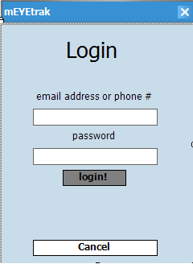
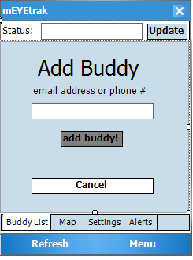
Client - GUI

Slide 5
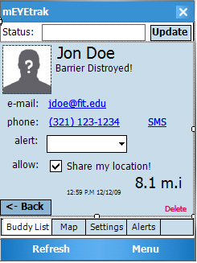
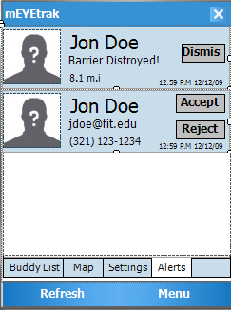
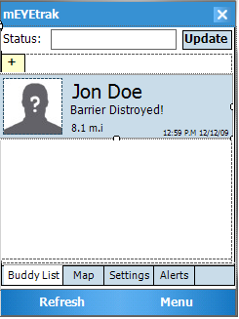
Client - GUI

Slide 6
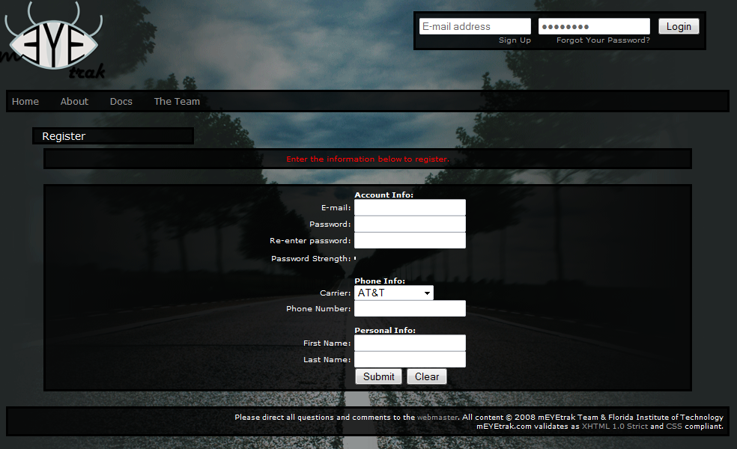
Website – Registration

Slide 7
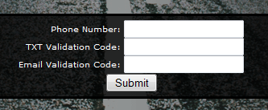
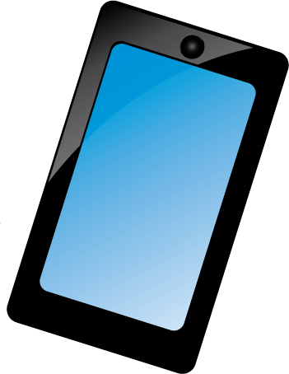

Website – Validation
Website
2x Validation
Codes
Email
Cell

Slide 8
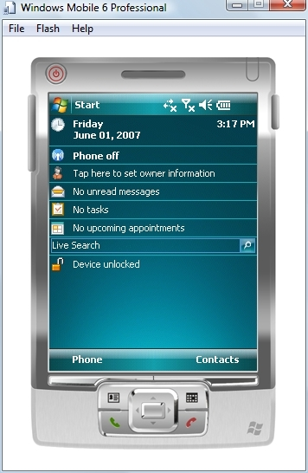
Testing Platform
Windows Mobile 6.1 Professional Emulator
Setup multiple platform images
  lack of real hardware to test
Enable network connectivity
  uses VirtualPC network driver
  cell emulation buggy
“Spoof” GPS data

Slide 9
Milestone 2 Tasks
Client Backend
  Test
Client GUI
  Test
  Integrate map-view of buddies, update settings, Stolen PhoneTrak
Application Server
  Test and Maintenance
Website
  Profile layout
  Add buddy, remove buddy, etc
  More Ajax goodness

Slide 10

Questions?
You’ll be saying “wow” every time

