Slide 1

Milestone 2
Ernie Costa
Michael Daniels
Lindsay Graham
Erik Olson
Dion St. Hilaire

Slide 2

Milestone 2 Tasks
Client Backend
  Test
Client GUI
  Test
  Integrate map-view of buddies, update settings, add buddies
Application Server
  Test and Maintenance
Website
  Fix registration/validation
  View buddies on map
  View profile

Slide 3
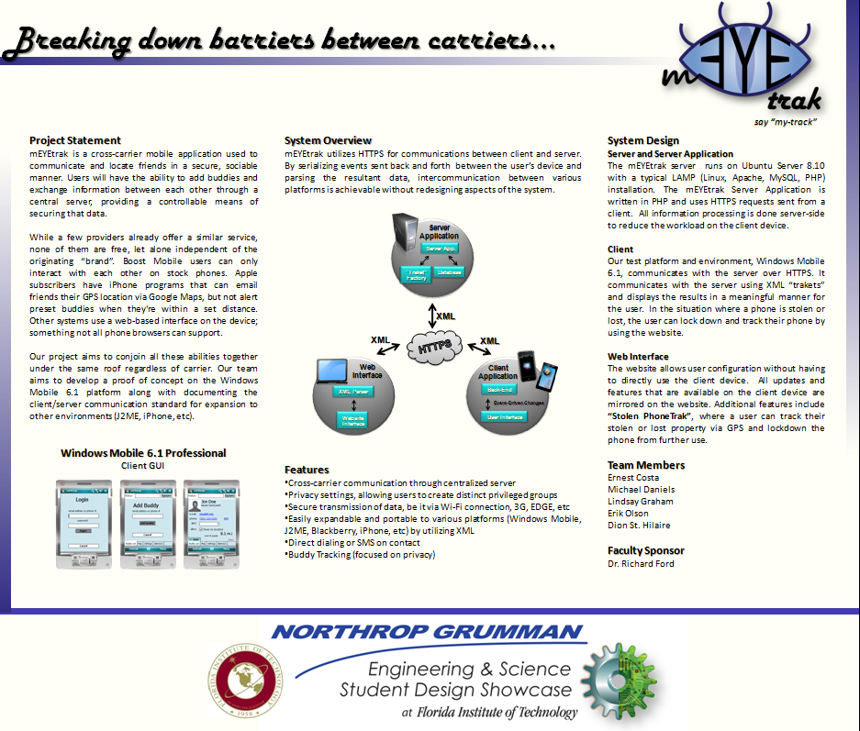
Poster

Slide 4

Client - Backend
Client Info
Connection Manager

Slide 5
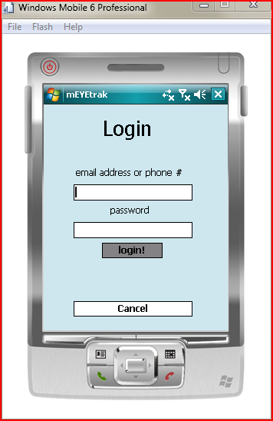
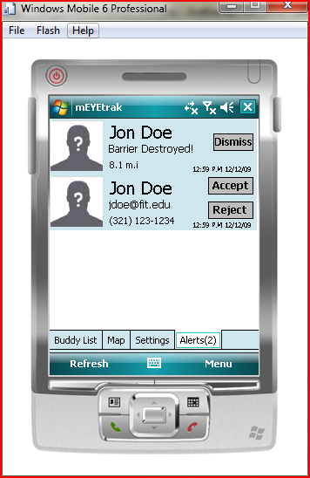
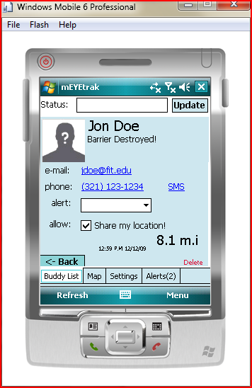
Client - GUI

Slide 6
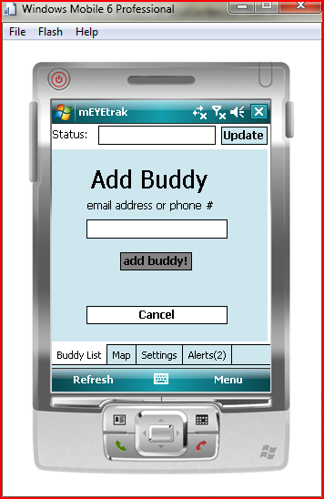
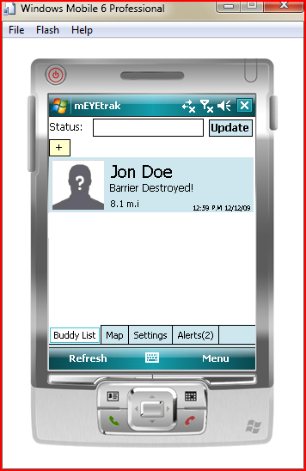
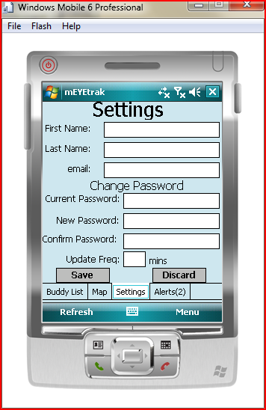
Client - GUI

Slide 7
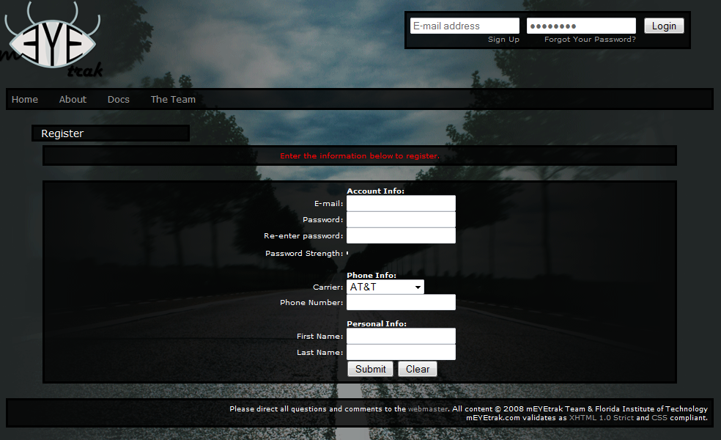
Website – Registration

Slide 8
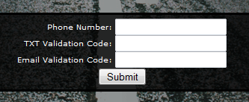


Website – Validation
Website
2x Validation
Codes
Email
Cell

Slide 9
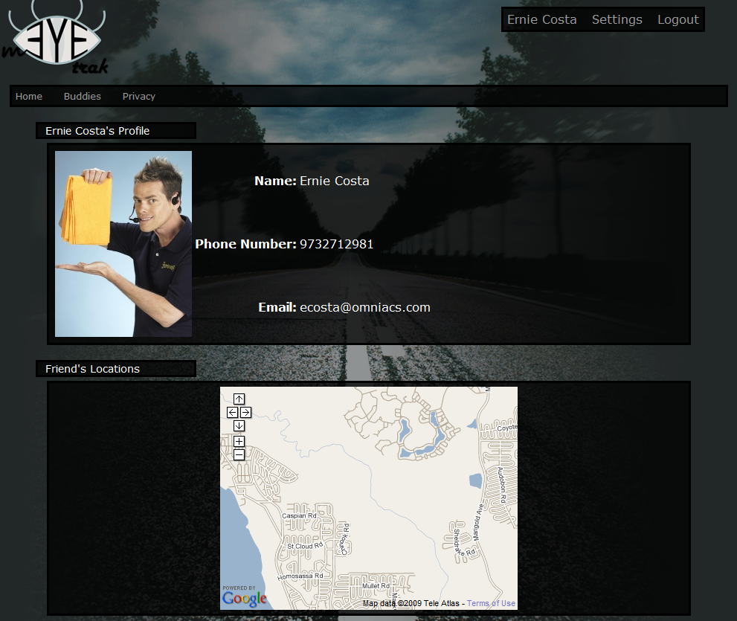
Website – Profile

Slide 10
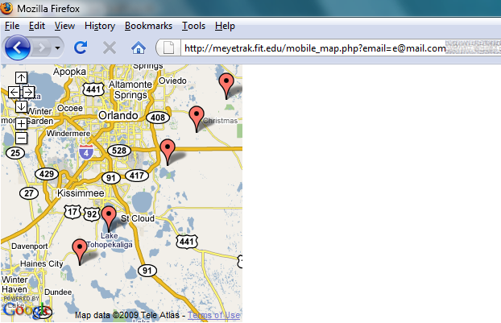
Website – Mobile Map

Slide 11
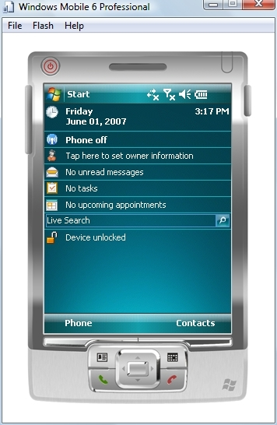
Testing Platform
Windows Mobile 6.1 Professional Emulator
Setup multiple platform images
  lack of real hardware to test
Enable network connectivity
  uses VirtualPC network driver
  cell emulation buggy
“Spoof” GPS data

Slide 12
Milestone 3
Task’ | Ernie | Mike | Lindsay | Erik | Devin
Client Backend | 0% | 100% | 0% | 0% | 0%
Client GUI | 0% | 0% | 0% | 0% | 100%
Server Application | 0% | 0% | 0% | 100% | 0%
Website | 100% | 0% | 0% | 0% | 0%
Testing | 0% | 0% | 100% | 0% | 0%
Video & Demonstration | 34% | 33% | 0% | 0% | 33%

Slide 13

Questions?
Chop your woes away!

