Slide 1
Milestone 3
Ernie Costa
Michael Daniels
Lindsay Graham
Erik Olson
Dion St. Hilaire

Slide 2
Milestone 3 Tasks
Video
Give detailed view of client
“User Friendly” explanations
Preserve video quality (TechSmith codec FTW)
Manual
Allow users to easily find and understand different topics
Documentation
Explain Trakets in an easy, standard way
Explain how the server handles new Trakets
Server documentation
Discuss possible features to be implemented down the road

Slide 3
Milestone 3 Task Matrix
Task | Ernie | Michael | Lindsay | Erik | Dion
Video | 100% | 0% | 0% | 0% | 0%
Manual | 0% | 33% | 0% | 33% | 33%
Documentation | 0% | 33% | 0% | 33% | 33%

Slide 4
Video
Click here to view the Video

Slide 5
Manual and Documentation
Click here to view the Document

Slide 6
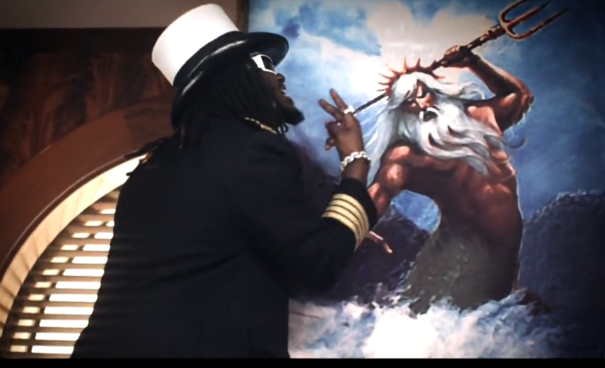
Questions?
Just look to Poseidon
“Anything is possible!”

